Slide 1

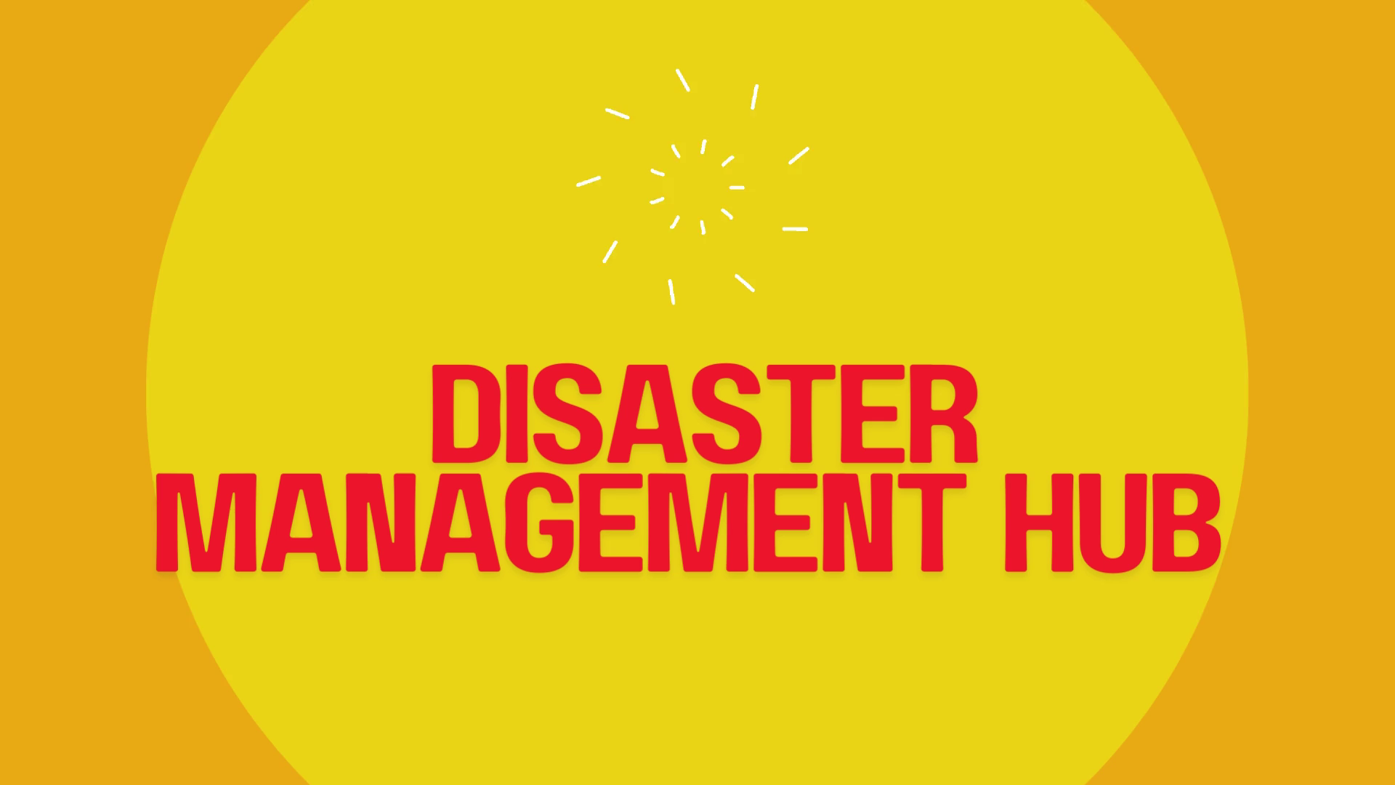
DISASTER MANAGEMENT
HUB

Slide 2

disaster management hub
Emergency management, also referred to as disaster management, means preparing for potential calamities and responding to them as quickly, strategically and effectively as possible. Typically, this involves following the basic disaster management cycle, which comprises five crucial stages.

Slide 3
contents
01
Introduction to disaster management
02
Current disaster management infrastructure
03
technologies used in disaster management
04
Emergency response

Slide 4
INTRODUCTION
risk exposures in coimbatore
objective of the hub
Coimbatore faces threats from earthquakes, floods, and heatwaves, necessitating robust disaster management strategies..
The hub aims to enhance preparedness levels, streamline response mechanisms, and expedite recovery efforts post disasters..
A
B
D
C
coordination of the hub
Establishing a centralized disaster management hub is crucial to coordinate emergency responses effectively and implement resilience strategies..

Slide 5
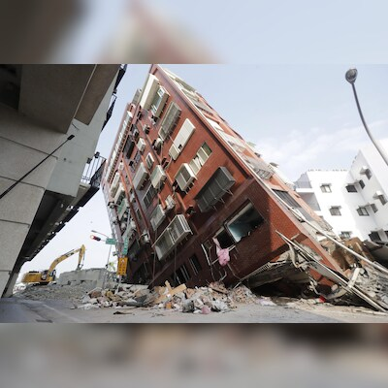
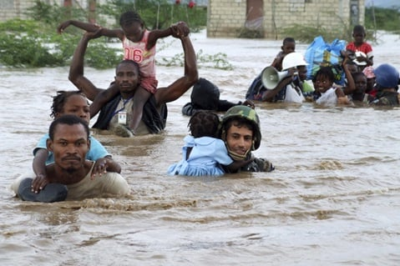
Disasters prone to coimbatore region
Earthquakes
FLOOD
HEAT WAVES

Slide 6
CURRENT INFRASTRUCTURE
BUILDING RETRIFITTING STRUCTURES
Public Education Enhancement
Retrofitting existing structures is crucial to enhancing safety and resilience against seismic events.
Increasing public awareness through education can improve overall community resilience during disasters.
4
5
2
1
3
Community Preparedness
Earthquake-Resistant Construction
Enforcing standards for earthquake-resistant buildings can significantly reduce potential damage and casualties..
While community engagement is robust, individual readiness remains low, highlighting a gap in personal preparedness.e.
.

Slide 7
TECHNOLOGIES USED IN DISASTER MANAGEMENT
01
03
05
Remote Sensing
Remote sensing is the science of acquiring information about the Earth's surface without actually being
in contact with it.
Database Management System (DBMS): is a computer based system that is used to store, manipulate
and retrieve data.
Decision Support System: Decision Support System can be defined as an integration of
computer hardware, software and methodology that is designed to complement the cognitive thinking of human
beings in their decision making
Management Information System: MIS would have to cater to the following types of information:
Planning Information - Certain standard norms and specifications are used in planning of any activity
Geographic Information System is a computer based system comprising hardware, software, data,
people and methodology that combine to provide answers to queries of a geographical nature as and when
required
.
02
04

Slide 8
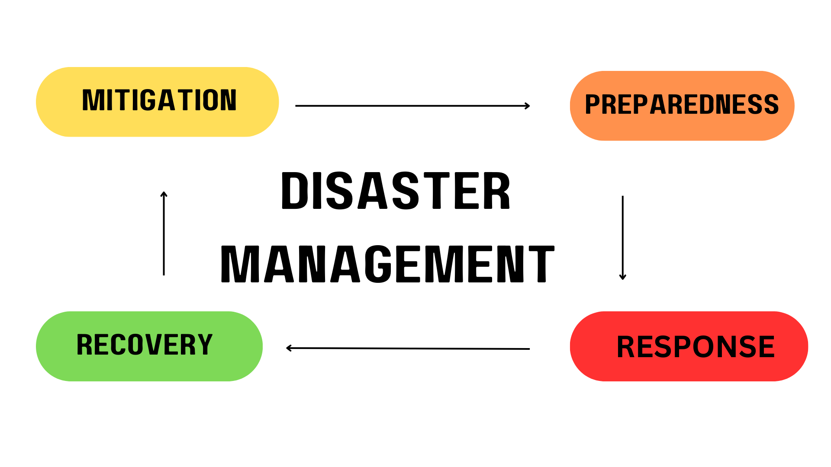
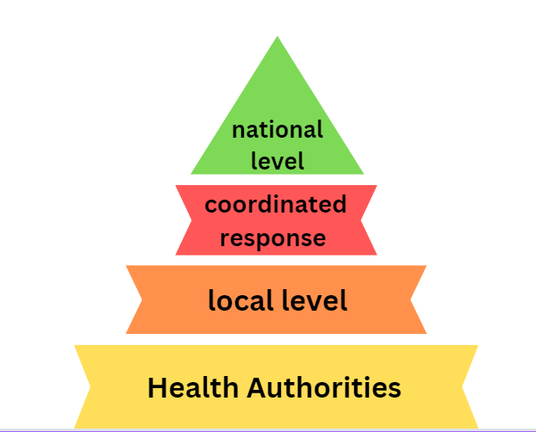
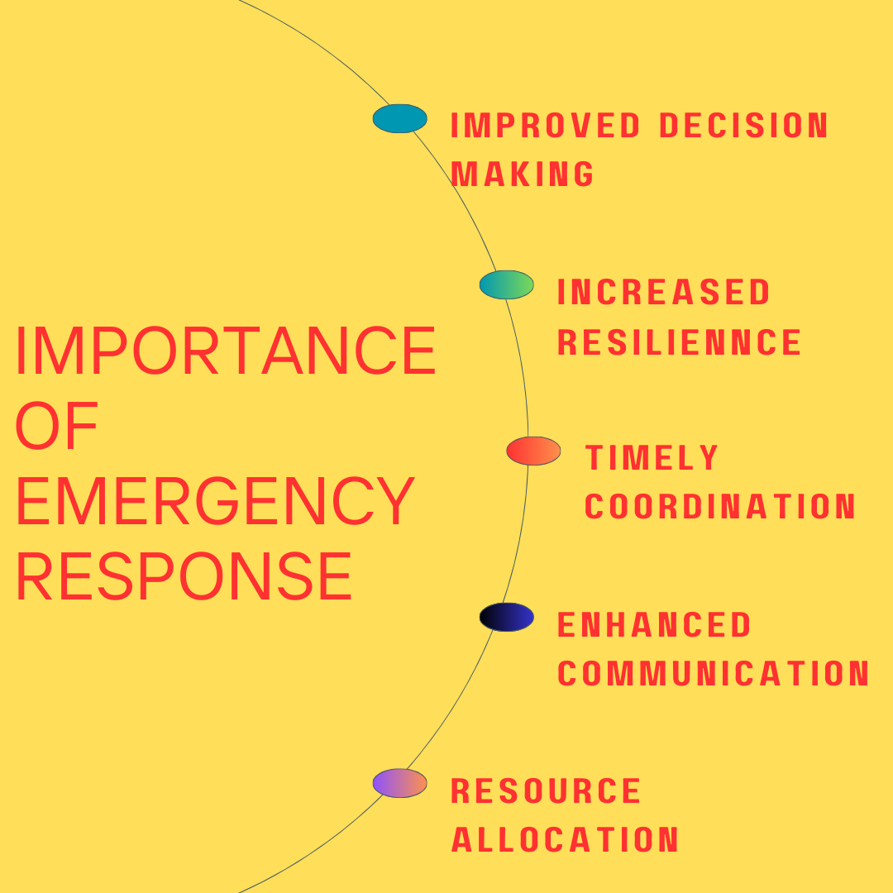

Slide 9
EMERGENCY RESPONSE
mitigation
preparedness
01
02
recovery
response
04
03

Slide 10
CONCLUSION
In conclusion, disaster management is not just a responsibility of governments and organizations but a collective duty of every individual
. By understanding the risks, preparing effectively, and responding swiftly, we can mitigate the impact of disasters and save lives
. Its about building resilient communities that can withstand the challenges of natural and man-made disasters.
Let us commit to being proactive, informed, and united in our efforts to protect ourselves and our environment. Together, we can turn potential tragedies into opportunities for learning and growth, ensuring a safer future for all..
https://disastermanagementhub.wordpress.com/

Slide 11
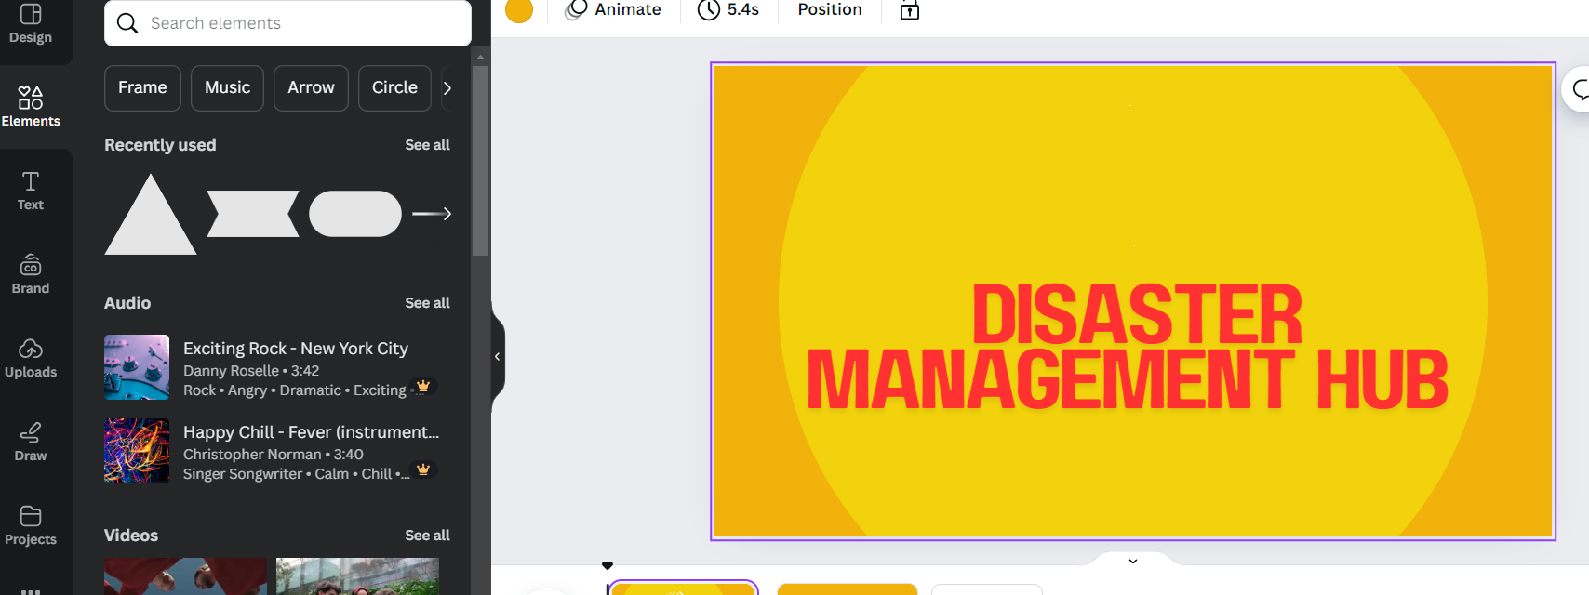
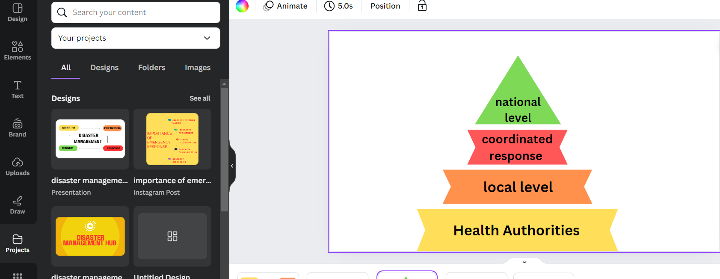
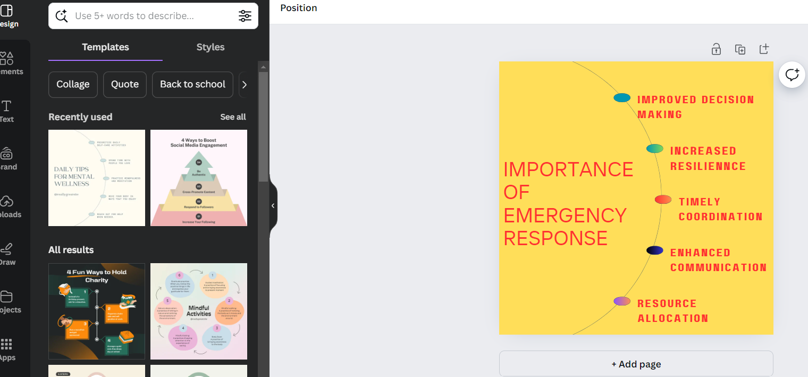
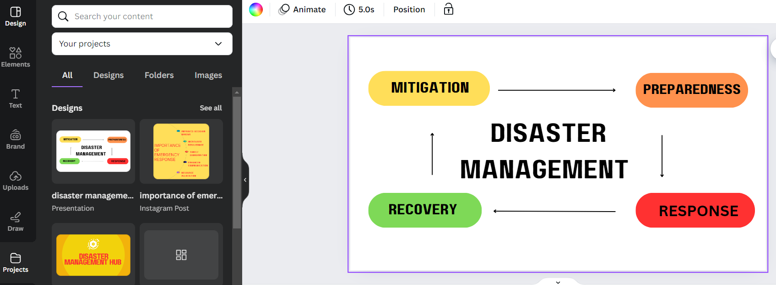

Slide 12
THANK YOU

